Slide 1
OULAD
Withdrawal and
academic failure
Stakeholder findings and proposed student support
52.80%
of enrollments ended in withdrawal or failure
October 2026
01
Notes:
Source: OULAD_Stakeholder_Report_Illustrated_EN.docx and saved outputs in Final_OULAD_Analysis_EN(1).ipynb. Unit: student enrollment in a module presentation, not unique students. Historical descriptive associations do not establish causality.
Scope: 32,593 enrollments, 28,785 unique students, 7 modules and 22 presentations in 2013–2014.

Slide 2
Withdrawal and failure affect 52.80%
32,593 enrollments across 7 modules and 22 presentations
17,208
affected enrollments
Success includes PASS and DISTINCTION. All rates use enrollments.
02
Notes:
Source: OULAD_Stakeholder_Report_Illustrated_EN.docx and saved outputs in Final_OULAD_Analysis_EN(1).ipynb. Unit: student enrollment in a module presentation, not unique students. Historical descriptive associations do not establish causality.
Counts: success 15,385, withdrawal 10,156, failure 7,052. Distinction 3,024 is included in success.

Slide 3
CCC and DDD have the highest combined rates
BBB and FFF have the largest case volumes: 4,155 and 4,114 affected enrollments
PROPOSED SUPPORT
CCC and DDD need retention support. BBB and FFF need capacity for case volume. GGG needs academic support.
03
Notes:
Source: OULAD_Stakeholder_Report_Illustrated_EN.docx and saved outputs in Final_OULAD_Analysis_EN(1).ipynb. Unit: student enrollment in a module presentation, not unique students. Historical descriptive associations do not establish causality.
Combined rates calculated from original counts: CCC 62.16%, DDD 58.39%, FFF 53.00%, BBB 52.54%, EEE 43.76%, GGG 40.25%, AAA 29.01%. Stacked labels use rounded component percentages. Review requirements and assessment sequencing in CCC/DDD. Allocate advisers by volume in BBB/FFF. Provide targeted practice and assessment preparation in GGG.

Slide 4
Half of withdrawals occur before month one ends
Percentages below describe shares of all 10,156 withdrawals
PROPOSED SUPPORT
Begin onboarding before teaching starts. Follow up missed activities in the first four weeks and continue support later.
04
Notes:
Source: OULAD_Stakeholder_Report_Illustrated_EN.docx and saved outputs in Final_OULAD_Analysis_EN(1).ipynb. Unit: student enrollment in a module presentation, not unique students. Historical descriptive associations do not establish causality.
Counts: 2,676 before start, 2,356 days 0–27, 5,031 day 28 onward, 93 unknown. Periods differ in length. These are not daily or equal-duration withdrawal rates. Check platform access and explain study time before the start.

Slide 5
Higher study loads coincide with more withdrawal
Combined withdrawal and failure rise from 48.20% to 69.64% across the load bands
PROPOSED SUPPORT
Review study time and commitments, especially above 120 credits. Offer weekly plans and permitted load adjustments.
05
Notes:
Source: OULAD_Stakeholder_Report_Illustrated_EN.docx and saved outputs in Final_OULAD_Analysis_EN(1).ipynb. Unit: student enrollment in a module presentation, not unique students. Historical descriptive associations do not establish causality.
Study load is total studied credits at enrollment, not the credits for this module alone. Bands contain 20,568, 9,769 and 2,256 enrollments. Offer individual advice before a high-load registration. Association does not demonstrate a causal effect.

Slide 6
Study load and withdrawal within each module
Withdrawal rises across the three load bands in all seven modules
PROPOSED SUPPORT
Prioritize workload reviews in CCC and DDD. Check each student’s circumstances before changing their study plan.
06
Notes:
Source: OULAD_Stakeholder_Report_Illustrated_EN.docx and saved outputs in Final_OULAD_Analysis_EN(1).ipynb. Unit: student enrollment in a module presentation, not unique students. Historical descriptive associations do not establish causality.
CCC rises from 37.22% to 62.84%, DDD from 28.59% to 60.08%. DDD has the largest gap, about 31.49 percentage points. Only 12 GGG enrollments exceed 120 credits. Differences remain unadjusted for presentation and student characteristics.

Slide 7
Previous attempts coincide with weaker outcomes
Combined withdrawal and failure: 66.92% with previous attempts versus 50.72% without
PROPOSED SUPPORT
Use a diagnostic assessment, set a repeat-study plan and review progress after the first assessment.
07
Notes:
Source: OULAD_Stakeholder_Report_Illustrated_EN.docx and saved outputs in Final_OULAD_Analysis_EN(1).ipynb. Unit: student enrollment in a module presentation, not unique students. Historical descriptive associations do not establish causality.
Groups contain 28,421 and 4,172 enrollments. Previous attempts refer to the same module. The 16.20 percentage-point combined gap is descriptive. The analysis does not estimate the effect of each additional attempt.

Slide 8
Deprivation and region both inform support needs
Combined outcomes vary between deprivation bands and between regions
37.9% of North Western enrollments are in IMD 0–20%, compared with 5.9% in South Region.
PROPOSED SUPPORT
Assess device and connectivity barriers. Offer downloadable materials and flexible access to support.
08
Notes:
Source: OULAD_Stakeholder_Report_Illustrated_EN.docx and saved outputs in Final_OULAD_Analysis_EN(1).ipynb. Unit: student enrollment in a module presentation, not unique students. Historical descriptive associations do not establish causality.
The first two bars compare deprivation bands across all regions. The last two compare regional totals. They have different denominators and are not adjusted comparisons. Wales has the highest regional failure, 29.72%, despite lower deprivation concentration than North Western. Missing IMD: North Region 40.1%, Ireland 22.5%. Percentages describe project enrollments, not regional populations. Allocate support by need while assessing individuals separately. Full regional chart in appendix.

Slide 9
Prior qualifications and final outcomes
Combined withdrawal and failure by highest prior qualification
PROPOSED SUPPORT
Offer foundational study skills and diagnostic checks, with worked examples and progressive practice.
09
Notes:
Source: OULAD_Stakeholder_Report_Illustrated_EN.docx and saved outputs in Final_OULAD_Analysis_EN(1).ipynb. Unit: student enrollment in a module presentation, not unique students. Historical descriptive associations do not establish causality.
No formal qualifications n=347 and postgraduate n=313 are relatively small groups. Other factors include module mix, study load and previous attempts. Support should include academic writing, numeracy and digital skills according to individual needs.

Slide 10
Assessment completion separates outcome groups
22.93% of eligible assessment opportunities have no submission record
PROPOSED SUPPORT
Provide a clear assessment calendar and reminders. Break large assignments into stages and check missing records.
10
Notes:
Source: OULAD_Stakeholder_Report_Illustrated_EN.docx and saved outputs in Final_OULAD_Analysis_EN(1).ipynb. Unit: student enrollment in a module presentation, not unique students. Historical descriptive associations do not establish causality.
Mean completion is calculated for each enrollment then averaged within the outcome. It differs from a pooled rate across assessment opportunities. Current eligible opportunities: 214,627. With a submission record:165,413. Without:49,214. For withdrawals, only due assessments while eligible are included.

Slide 11
Submission support needs differ by module
On-time submissions as a percentage of all eligible assessment opportunities
PROPOSED SUPPORT
Review completion gaps in GGG, EEE and FFF. Investigate deadline difficulties in CCC.
11
Notes:
Source: OULAD_Stakeholder_Report_Illustrated_EN.docx and saved outputs in Final_OULAD_Analysis_EN(1).ipynb. Unit: student enrollment in a module presentation, not unique students. Historical descriptive associations do not establish causality.
Chart uses on-time submissions divided by eligible assessment opportunities, including opportunities without a submission. It is not a completion rate or the on-time share of actual submissions. Completion shares (failed then withdrawn):AAA63.2%/70.1%,BBB43.2%/57.4%,CCC46.2%/60.6%,DDD50.4%/61.6%,EEE34.7%/51.8%,FFF35.9%/60.5%,GGG28.3%/57.3%. Verify completeness and clarify requirements and marking criteria.

Slide 12
Early activity differs by final outcome
Median active days during days 0–27, among full-window eligible enrollments with records
PROPOSED SUPPORT
Make first-week activities clear and connect resources to assessments. Contact students to understand barriers to activity.
12
Notes:
Source: OULAD_Stakeholder_Report_Illustrated_EN.docx and saved outputs in Final_OULAD_Analysis_EN(1).ipynb. Unit: student enrollment in a module presentation, not unique students. Historical descriptive associations do not establish causality.
Sample 26,754 full-window eligible enrollments with interaction records. 475 eligible enrollments lack records and are excluded, not automatically treated as zero activity. Median clicks: distinction287,pass210,failure109,withdrawal144. Early withdrawals are outside this full-window comparison.

Slide 13
Early engagement varies across modules
Median active days in days 0–27 for pass, failure and withdrawal
PROPOSED SUPPORT
Interpret engagement using each module’s patterns. Combine activity with grades and expected submissions.
13
Notes:
Source: OULAD_Stakeholder_Report_Illustrated_EN.docx and saved outputs in Final_OULAD_Analysis_EN(1).ipynb. Unit: student enrollment in a module presentation, not unique students. Historical descriptive associations do not establish causality.
These series use PASS alone, not combined SUCCESS. In AAA, median clicks for withdrawal275 and pass279.5 are close, so volume alone is insufficient. Do not apply one click threshold across modules. Same full-window selection as the prior slide.

Slide 14
Weekly engagement needs context
Mean recorded clicks during the first four eligible weeks
PROPOSED SUPPORT
Follow sustained declines relative to the student’s prior activity. Offer contact and a plan to regain progress.
14
Notes:
Source: OULAD_Stakeholder_Report_Illustrated_EN.docx and saved outputs in Final_OULAD_Analysis_EN(1).ipynb. Unit: student enrollment in a module presentation, not unique students. Historical descriptive associations do not establish causality.
Weekly samples change with eligibility and withdrawal. Means include zero-click weeks among enrollments with any interaction records. Lines describe changing groups, not fixed individual trajectories. Interpret timing with assessment calendars. Full-course charts and measured sample sizes appear in appendix.

Slide 15
Submission adds information beyond engagement
Success rates by joint early engagement and submission group
PROPOSED SUPPORT
High activity with low submission needs assessment support. Low activity and low submission needs priority individual contact.
15
Notes:
Source: OULAD_Stakeholder_Report_Illustrated_EN.docx and saved outputs in Final_OULAD_Analysis_EN(1).ipynb. Unit: student enrollment in a module presentation, not unique students. Historical descriptive associations do not establish causality.
Window0–27. High engagement: positive clicks at/above presentation median. High submission: at least80% of assessments due in window submitted by day27. n=21,533 inAAA,BBB,CCC,DDD,FFF. ExcludesEEE/GGG. Group sizes10,567,241,8,730,1,995. High-engagement/low-submission group is small. Thresholds are exploratory. Low engagement/high submission: review grades, learning quality and study methods. Both high: routine monitoring and enrichment.

Slide 16
Proposed support priorities
Responsibilities and focus areas for a limited pilot
Course leaders
CCC and DDD
Review retention barriers and assessment sequencing
Student support
BBB and FFF
Match adviser capacity to the volume of cases
Academic advisers
High load and repeat attempts
Agree realistic study plans and diagnostic support
Teaching teams
GGG, EEE, FFF and CCC
Address missing submissions and deadline difficulties
Access support
Students facing access barriers
Offer low-data resources and flexible support hours
16
Notes:
Source: OULAD_Stakeholder_Report_Illustrated_EN.docx and saved outputs in Final_OULAD_Analysis_EN(1).ipynb. Unit: student enrollment in a module presentation, not unique students. Historical descriptive associations do not establish causality.
Proposed responsibilities are recommendations for stakeholder agreement, not existing assigned commitments. Assess needs individually. Regional deprivation is not a diagnosis of an individual student’s needs.

Slide 17
Pilot evaluation and stakeholder decisions
A measured rollout connects support activity to student outcomes
Primary outcome
Pilot decisions
Combined withdrawal
and failure
Agree the pilot modules and support owners
Confirm capacity and individual eligibility
52.80%
Track completion, retention and success
Historical project baseline
Compare similar groups within the same module and presentation before expanding
Descriptive findings guide a pilot. They do not establish causes or validate an early-warning model.
17
Notes:
Source: OULAD_Stakeholder_Report_Illustrated_EN.docx and saved outputs in Final_OULAD_Analysis_EN(1).ipynb. Unit: student enrollment in a module presentation, not unique students. Historical descriptive associations do not establish causality.
52.80% is the historical whole-project baseline, not necessarily the baseline for selected pilot modules. Establish module/presentation-specific baselines for evaluation. Randomized or otherwise well-matched comparison groups strengthen assessment where feasible. No numerical improvement target or promised effect is assumed.

Slide 18
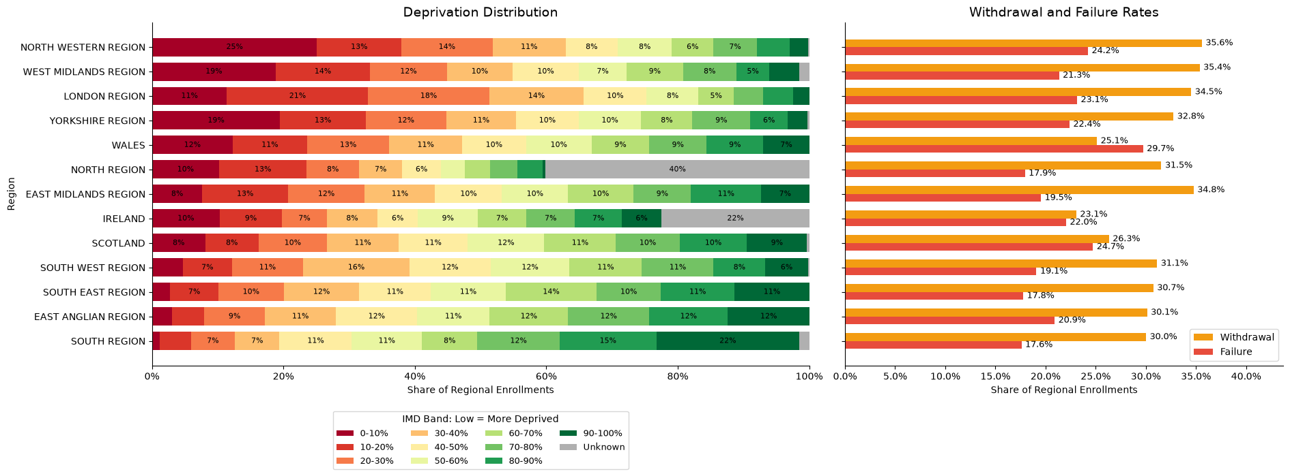
Appendix Regional deprivation and outcomes
Original notebook evidence for regional comparisons
Lower IMD bands indicate greater deprivation. Project enrollments are not regional population estimates.
18
Notes:
Source: OULAD_Stakeholder_Report_Illustrated_EN.docx and saved outputs in Final_OULAD_Analysis_EN(1).ipynb. Unit: student enrollment in a module presentation, not unique students. Historical descriptive associations do not establish causality.
Original notebook cell31. Missing IMD data40.1%NorthRegion and22.5%Ireland. Full regional distributions and withdrawal/failure rates retained.

Slide 19
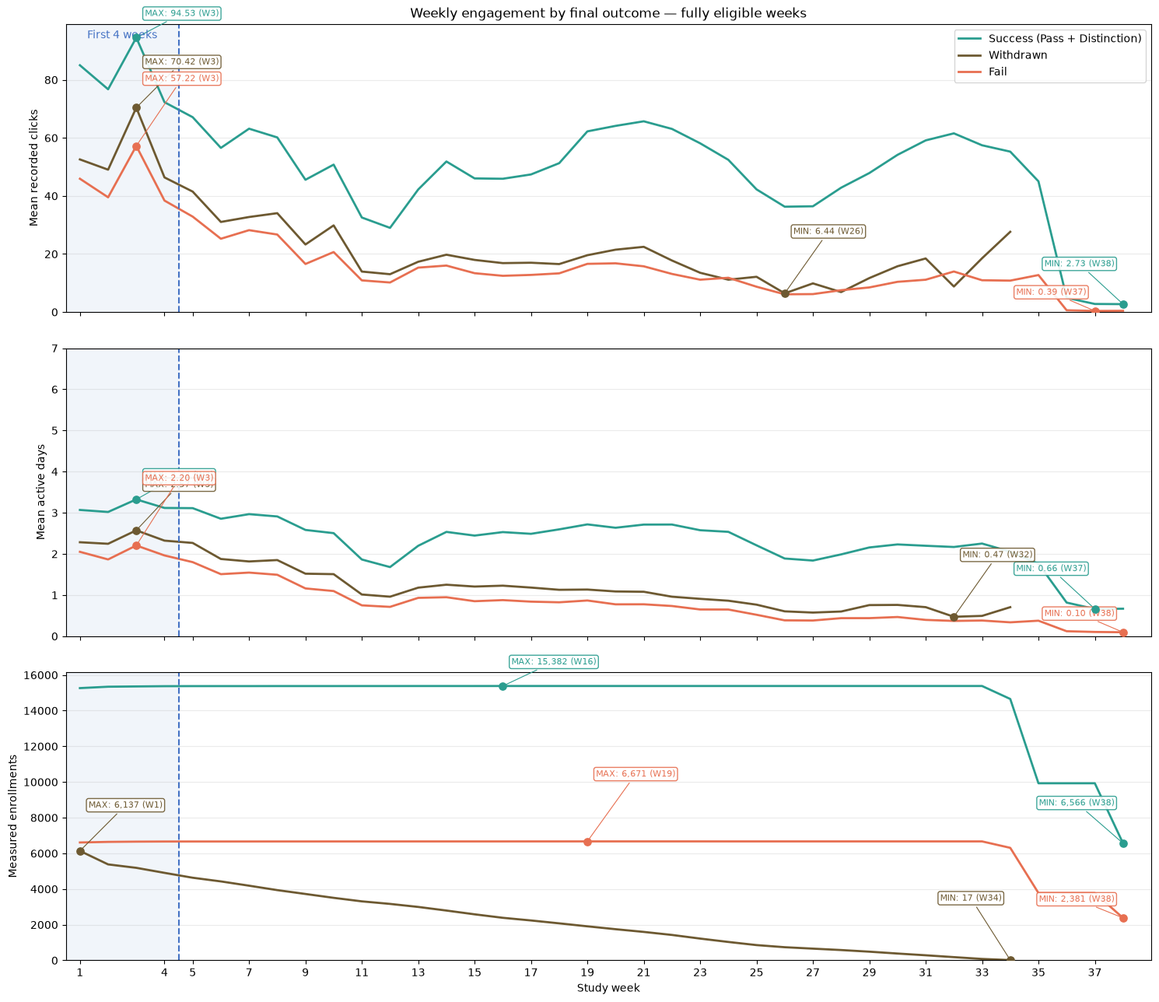
Appendix Engagement across the full course
Original notebook chart with weekly sample sizes
Reading the chart
Success includes pass and distinction.
The measured sample changes each week.
The withdrawal line ends when eligible weeks cease.
19
Notes:
Source: OULAD_Stakeholder_Report_Illustrated_EN.docx and saved outputs in Final_OULAD_Analysis_EN(1).ipynb. Unit: student enrollment in a module presentation, not unique students. Historical descriptive associations do not establish causality.
Original notebook cell143. Weekly means include full-week eligible enrollments with any interaction records, including their zero-click weeks. Do not infer fixed-person trajectories or treat the withdrawal line as zero after eligibility ceases.

